Slide 1
DDS Unit 1: LS Assignment
Dawson
5/3/2020
GitHub: or https://shorturl.at/lqLV8

Slide 2
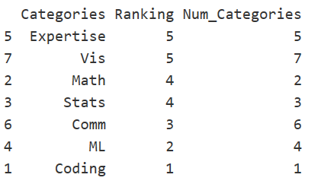
Q1: Bar chart of Data Science Profile
library(ggplot2)
categories = c('Coding', 'Math', 'Stats', 'ML', 'Expertise','Comm', 'Vis')
num_categories = c(1,2,3,4,5,6,7)
ranking = c(1, 4, 4, 2, 5, 3,5)
categories
ranking
class(categories)
class(ranking)
Dawson = data.frame(Categories = categories, Ranking = as.numeric(ranking), Num_Categories = num_categories)
Dawson
Dawson_Sorted = Dawson[order(-Dawson$Ranking),] #Sort dat for visualization descending Ranking
Dawson_Sorted
#help("barplot") Proved to be limited and searched for another option: Found ggplot to be more helpful
ggplot(Dawson_Sorted, aes(x =reorder(Categories, -Ranking), y = Ranking)) + geom_col(aes(fill = Categories)) + theme( plot.title = element_text(hjust = 0.5),
plot.subtitle = element_text(hjust = 0.5)) + ggtitle("Dawson's Data Science Profile") + xlab("Categories") + ylab("Skill Level") + geom_text(aes(label =Ranking)) + labs(subtitle = "Categories by Skill Level")

Slide 3

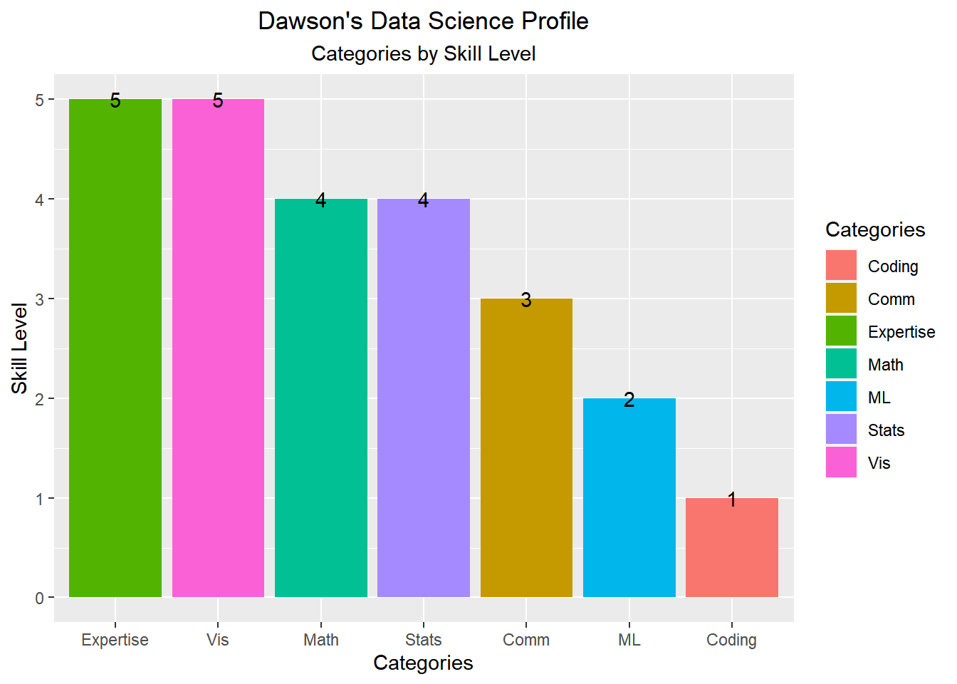
With extensive stats in healthcare, MSDS ML/Coding will increase speed to market within healthcare. - Covid19

Slide 4

Q2: a. 10M Chisq distrib. DF = 2
n = 1000000
ChiSqrPop = rchisq(n,2)
hist(ChiSqrPop, xlim =c(0,15))
sd(ChiSqrPop)
mean(ChiSqrPop)
summary(ChiSqrPop)
*Provided Central Limit Theorum, means and sd should be the same for population and sample

Slide 5
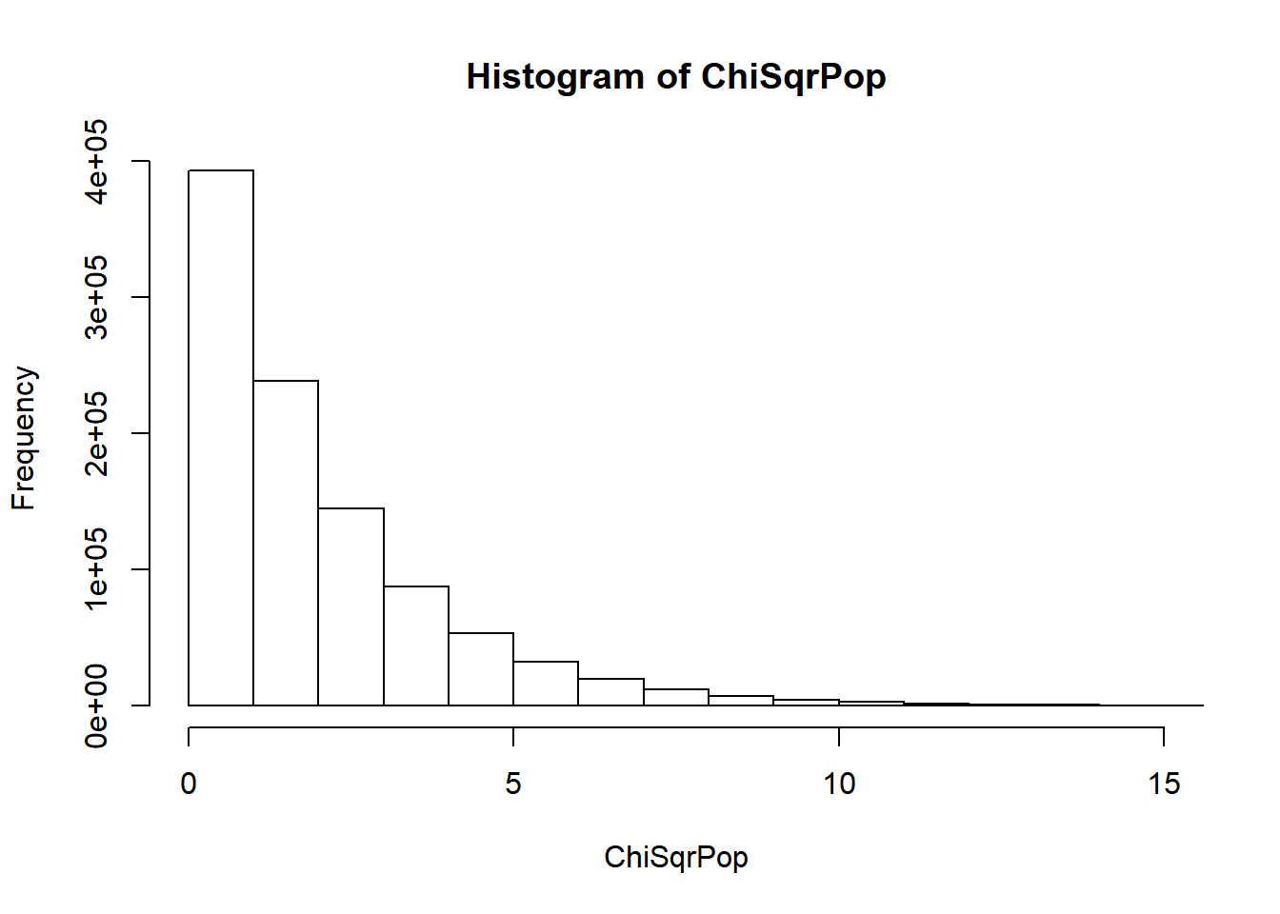
Chi Square Population is significantly skewed to the right. Population doesn’t follow

Slide 6
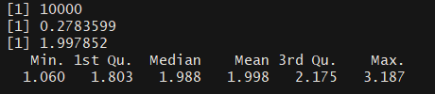
Q2: b. From sample.a 10k means from sample size 50
xbarGenerator = function(sampleSize = 50,number_of_samples = 10000) {
xBarVec = c()
for(i in 1:number_of_samples) {
theSample = sample(ChiSqrPop,sampleSize)
xbar = mean(theSample)
xBarVec = c(xBarVec, xbar)
}
return(xBarVec)
}
xbars = xbarGenerator(50,10000)
length(xbars)
#> [1] 1000
hist(xbars)
sd(xbars)
mean(xbars)
summary(xbars)

Slide 7
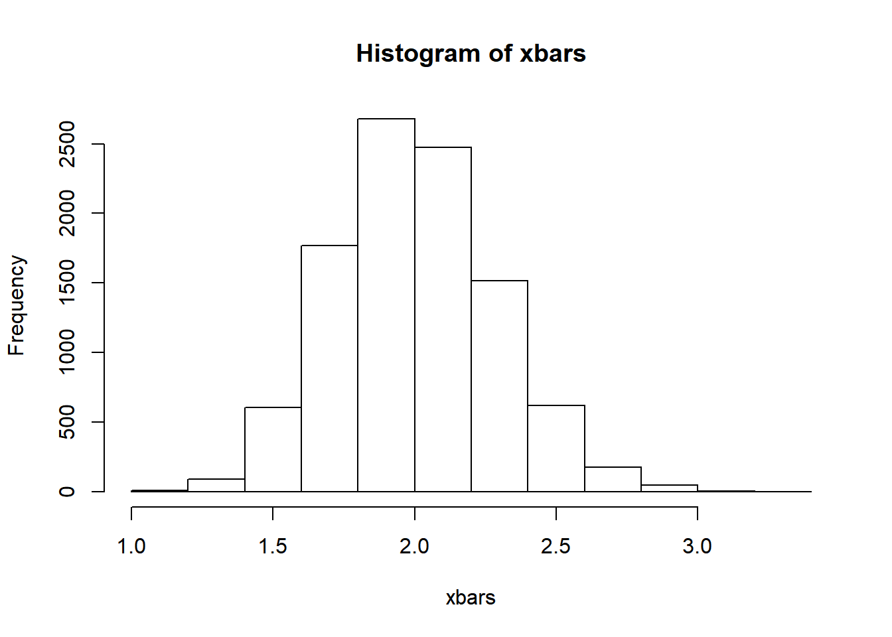
Distribution of the Chi-square sampling normalizes if n is LARGE enough.

Slide 8
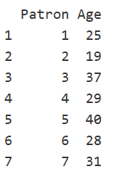
Q3: Is the Bomber Comber Mean age 21?
H_{o} sample µ = 21
H_{a} µ ≠ 21
PatronID = as.factor(c(1,2,3,4,5,6,7))
age = c(25, 19, 37, 29, 40, 28, 31)
BeachComber = data.frame(Patron = PatronID, Age = age)
BeachComber
hist(BeachComber$Age, main = "BeachComber # of Patrons by Age", xlab = "Age", ylab = "Patrons")
summary(BeachComber)
sd(BeachComber$Age)
t.test(BeachComber$Age, mu=21)
# Ho: µ (mu) =21
#Reject the null hypothesis. Beach Comber patrons mean age is different (p-value<0.01).

Slide 9
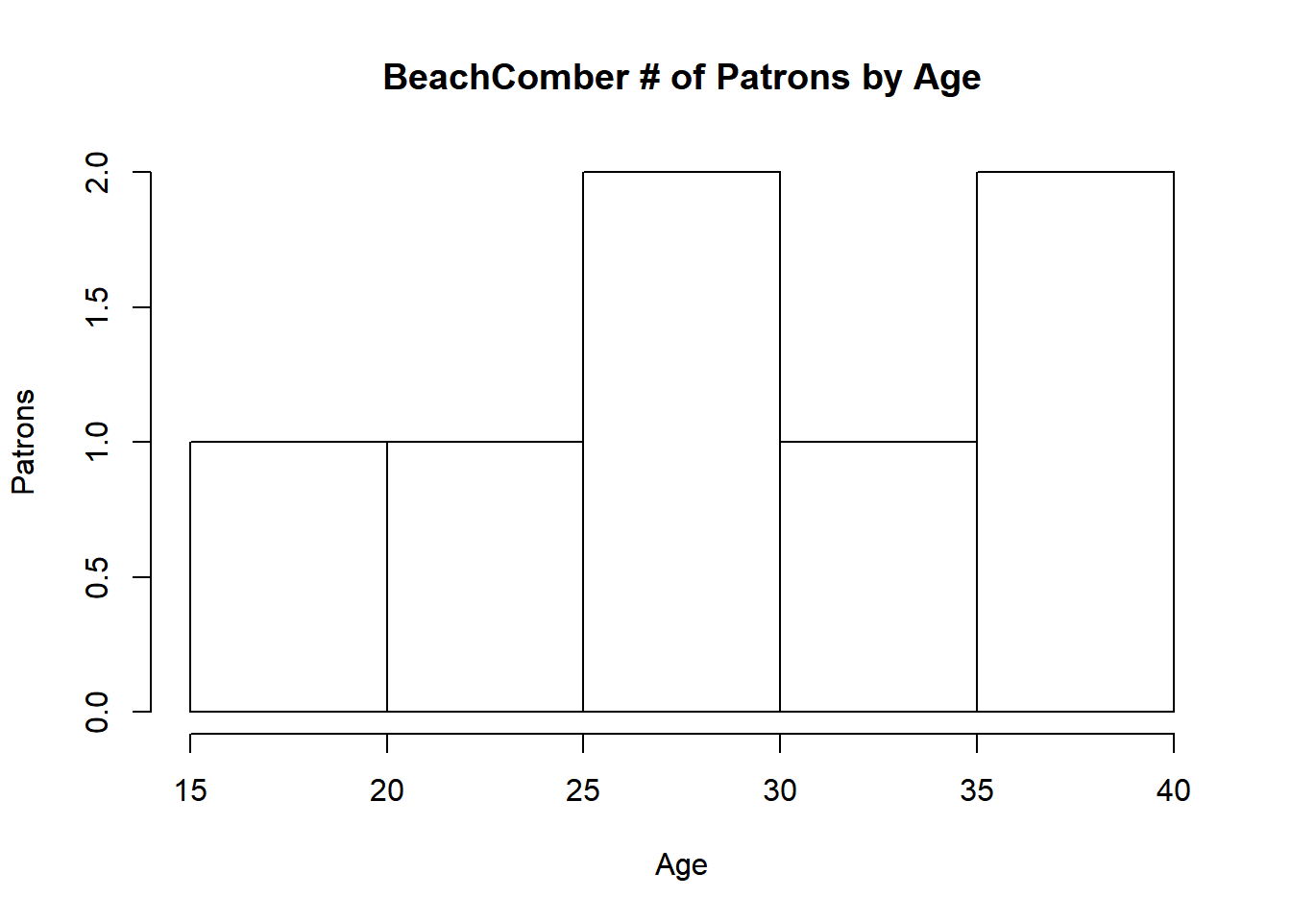
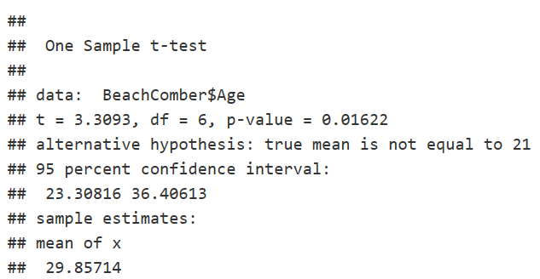
One-Sample T-test Beachcomber average Age is not 21 (p-value<0.01).

Slide 10
Takeaways
Questions
CLT population and sample mimic each other statistically when n is LARGE.
Reproducibility: All code, figures, and dependencies outlined for variation of results, including Session(); while all could be wrong
Data is not objective. A model is an attempt to understand and represent the nature of reality through a lense(). Starting with EDA & known assumptions are key. Starting with basic summary(), hist(), and box-plot-whisker() goes a long way fundamentally.
Scientific Method: Question > background research > hypothesis > test with experiment, analysis & conclusion > Communication of Results.
Data Science: Creating order from chaos. Ask questions.
Explain the relationship between Standard Deviation & Standard Error.
How would you organize into your personal Github?
Assume Normal distribution? Real data isn't this way, or is it? How do we account for this? In my field minimize outliers.

